Slide 1
“Helping the world efficiently
publish its knowledge”
Pete Binfield
Co-Founder and Publisher
PeerJ
CRIStin Meeting, Norway 04/28/2014
@p_binfield
pete@peerj.com
@ThePeerJ
https://peerj.com

Slide 3
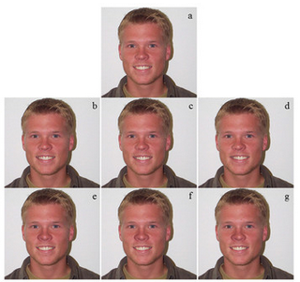
Motivations to Start PeerJ
“We started submitting in June 2005 - so its been close to 9 years of submissions”

Slide 4
Motivations to Start PeerJ

Slide 5
Motivations to Start PeerJ

Slide 6
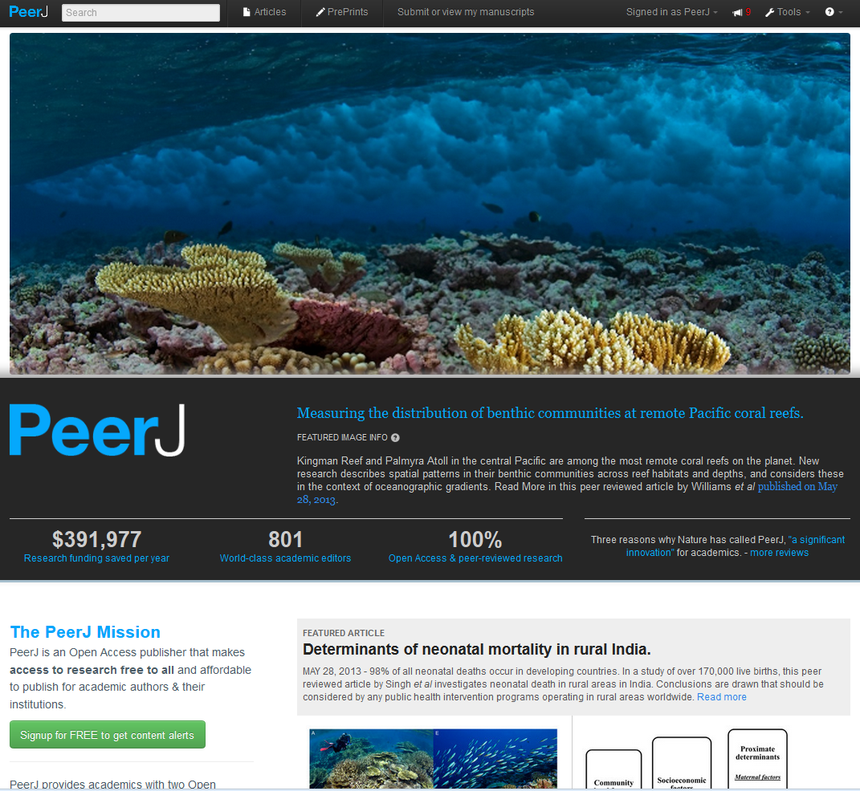

Slide 7
Interesting Features
PeerJ
an entirely new Open Access business model
a broad based journal in the biological and medical sciences, judging submissions based only on technical and scientific validity
fully peer reviewed, with rapid review process handled by a (very) large editorial board
encouraging of ‘Open Peer Review’
Q&A / Feedback / reputation system
PeerJ PrePrints
a preprint server for the biological and medical sciences
versioning
closely integrated with the journal
Q&A / Feedback
= New Features and Functionality Enabled by the Membership Model…

Slide 8
Interesting Features
PeerJ
an entirely new Open Access business model
a broad based journal in the biological and medical sciences, judging submissions based only on technical and scientific validity
fully peer reviewed, with rapid review process handled by a (very) large editorial board
encouraging of ‘Open Peer Review’
Q&A / Feedback / reputation system
PeerJ PrePrints
a preprint server for the biological and medical sciences
versioning
closely integrated with the journal
Q&A / Feedback
= New Features and Functionality Enabled by the Membership Model…

Slide 9
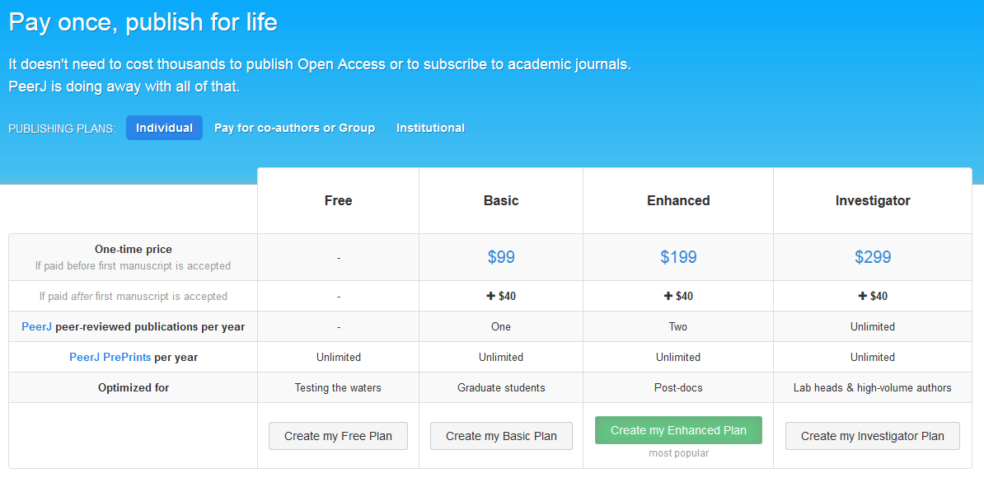

Slide 10
Interesting Features
PeerJ
an entirely new Open Access business model
a broad based journal in the biological and medical sciences, judging submissions based only on technical and scientific validity
fully peer reviewed, with rapid review process handled by a (very) large editorial board
encouraging of ‘Open Peer Review’
Q&A / Feedback / reputation system
PeerJ PrePrints
a preprint server for the biological and medical sciences
versioning
closely integrated with the journal
Q&A / Feedback
= New Features and Functionality Enabled by the Membership Model…

Slide 11
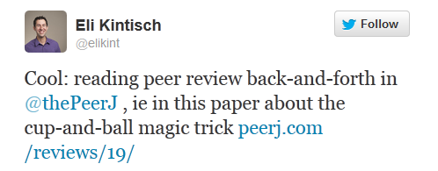
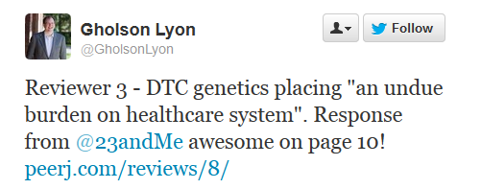
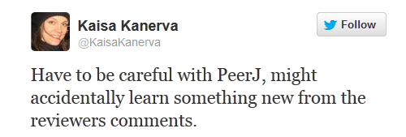

Slide 12
Interesting Features
PeerJ
an entirely new Open Access business model
a broad based journal in the biological and medical sciences, judging submissions based only on technical and scientific validity
fully peer reviewed, with rapid review process handled by a (very) large editorial board
encouraging of ‘Open Peer Review’
Q&A / Feedback / reputation system
PeerJ PrePrints
a preprint server for the biological and medical sciences
versioning
closely integrated with the journal
Q&A / Feedback
= New Features and Functionality Enabled by the Membership Model…

Slide 13
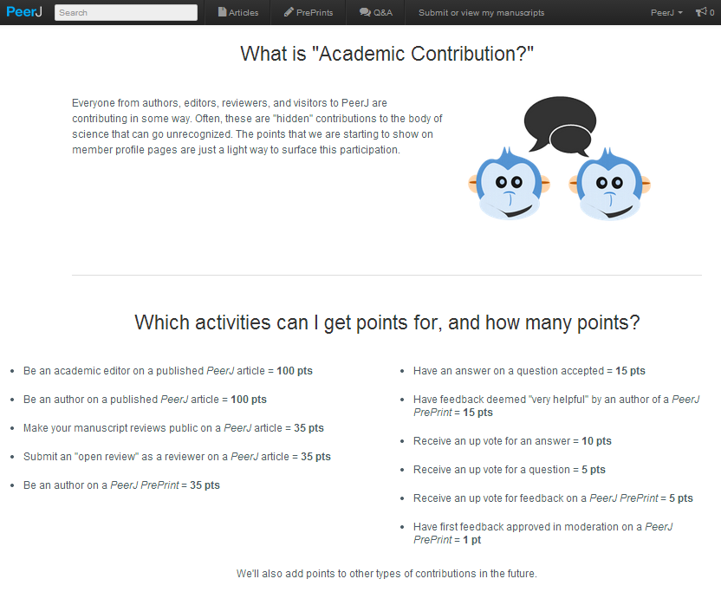

Slide 14
Interesting Features
PeerJ
an entirely new Open Access business model
a broad based journal in the biological and medical sciences, judging submissions based only on technical and scientific validity
fully peer reviewed, with rapid review process handled by a (very) large editorial board
encouraging of ‘Open Peer Review’
Q&A / Feedback / reputation system
PeerJ PrePrints
a preprint server for the biological and medical sciences
versioning
closely integrated with the journal
Q&A / Feedback
= New Features and Functionality Enabled by the Membership Model…

Slide 15
Interesting Features
PeerJ
an entirely new Open Access business model
a broad based journal in the biological and medical sciences, judging submissions based only on technical and scientific validity
fully peer reviewed, with rapid review process handled by a (very) large editorial board
encouraging of ‘Open Peer Review’
Q&A / Feedback / reputation system
PeerJ PrePrints
a preprint server for the biological and medical sciences
versioning
closely integrated with the journal
Q&A / Feedback
= New Features and Functionality Enabled by the Membership Model…

Slide 16
https://peerj.com/preprints/297/

Slide 17
Interesting Features
PeerJ
an entirely new Open Access business model
a broad based journal in the biological and medical sciences, judging submissions based only on technical and scientific validity
fully peer reviewed, with rapid review process handled by a (very) large editorial board
encouraging of ‘Open Peer Review’
Q&A / Feedback / reputation system
PeerJ PrePrints
a preprint server for the biological and medical sciences
versioning
closely integrated with the journal
Q&A / Feedback
= New Features and Functionality Enabled by the Membership Model…

Slide 19
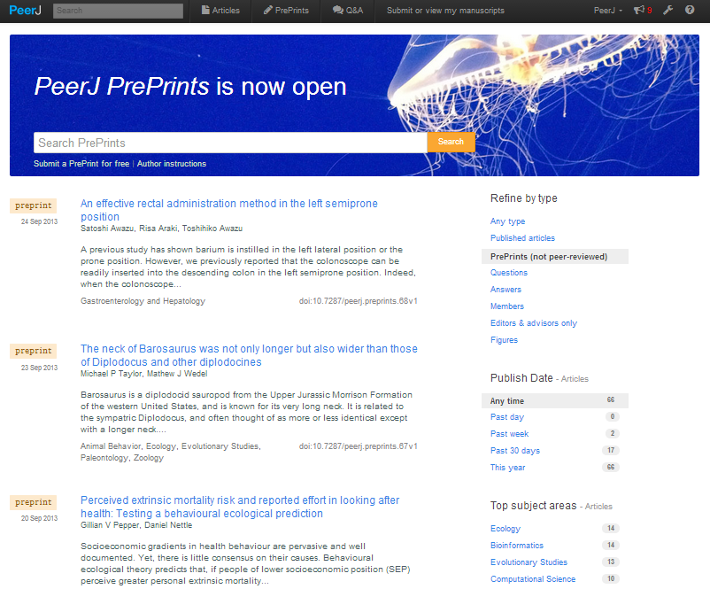

Slide 20
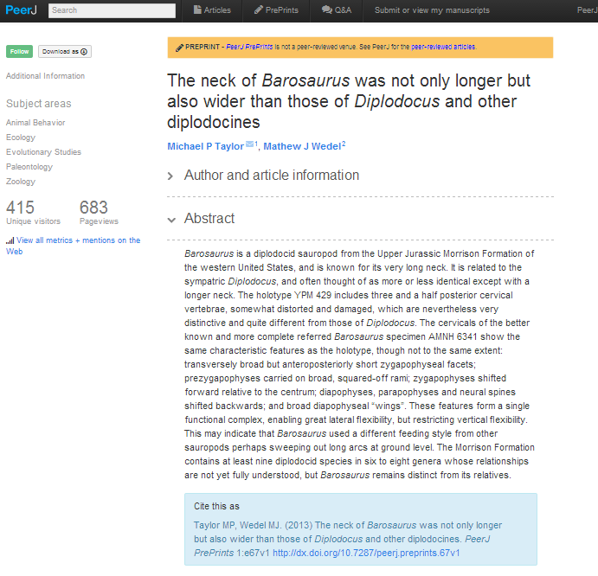

Slide 21
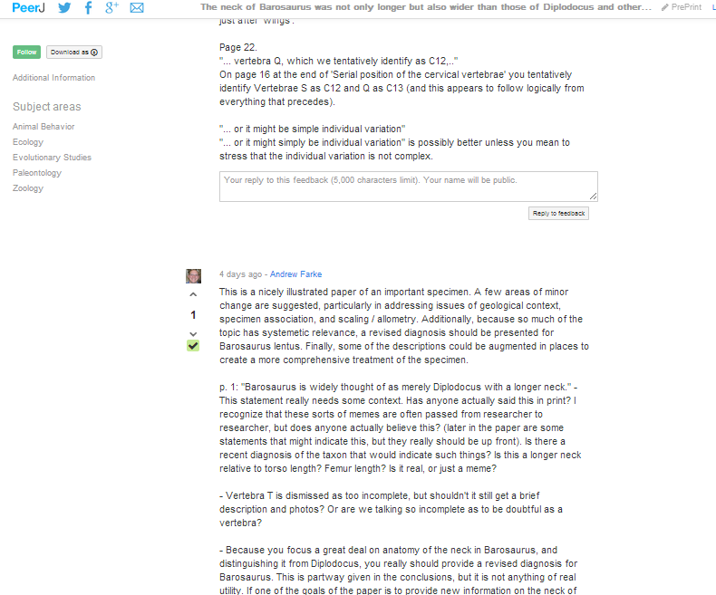

Slide 22
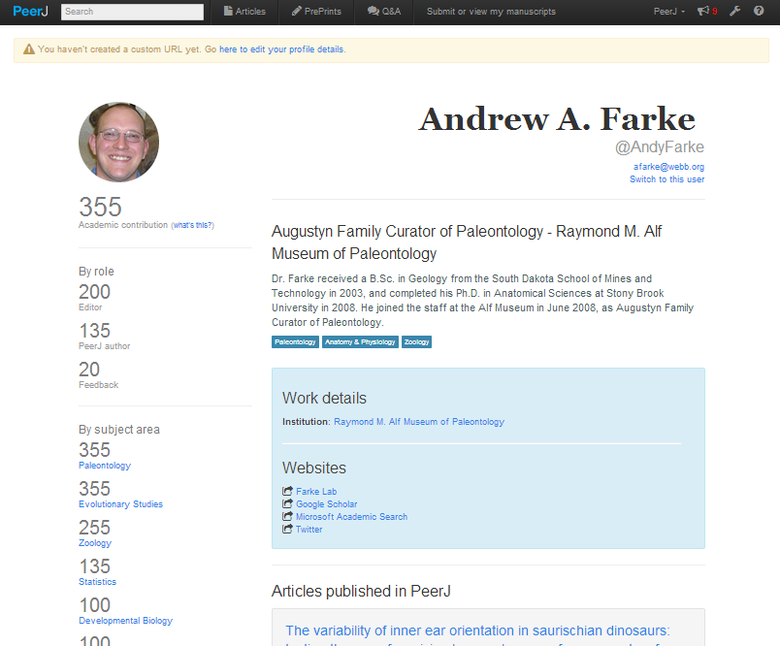

Slide 23
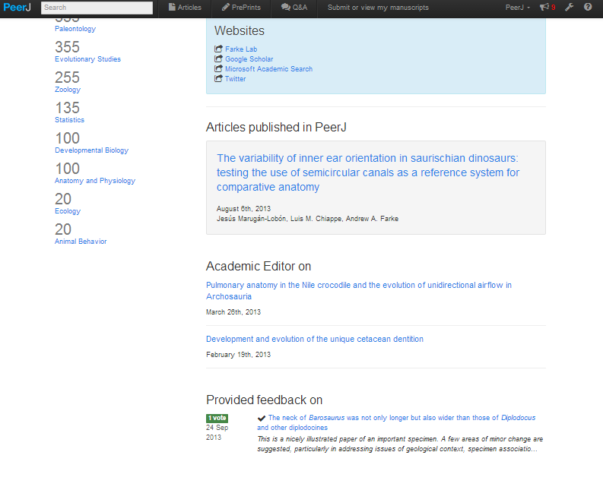

Slide 24
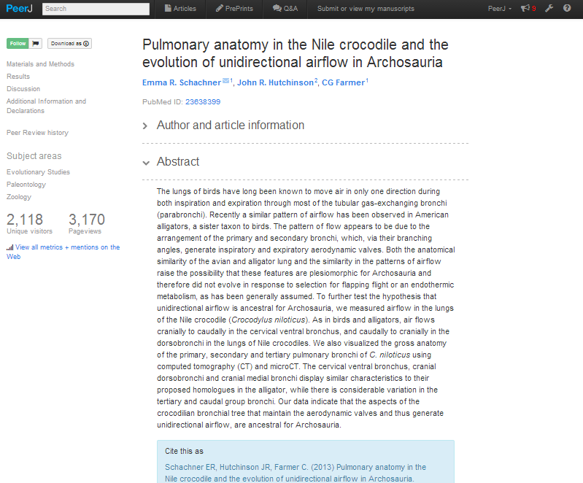

Slide 25
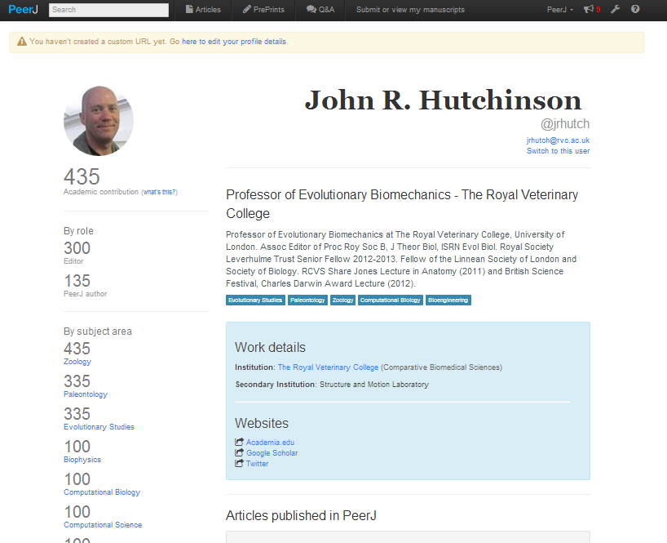

Slide 26
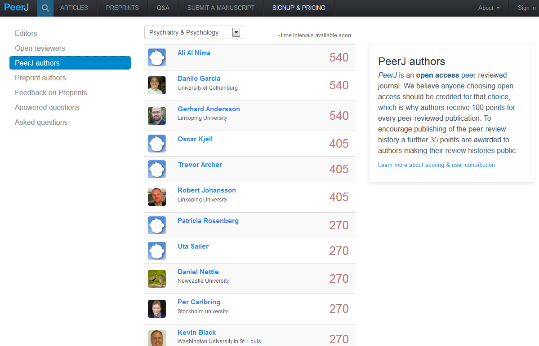

Slide 27
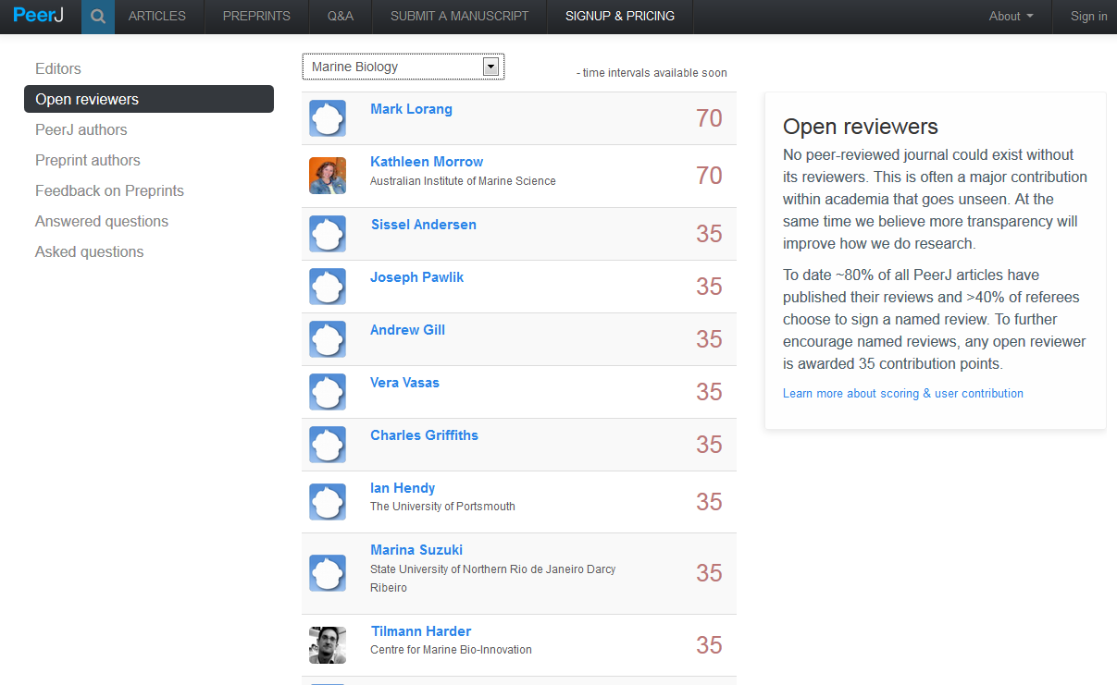

Slide 28
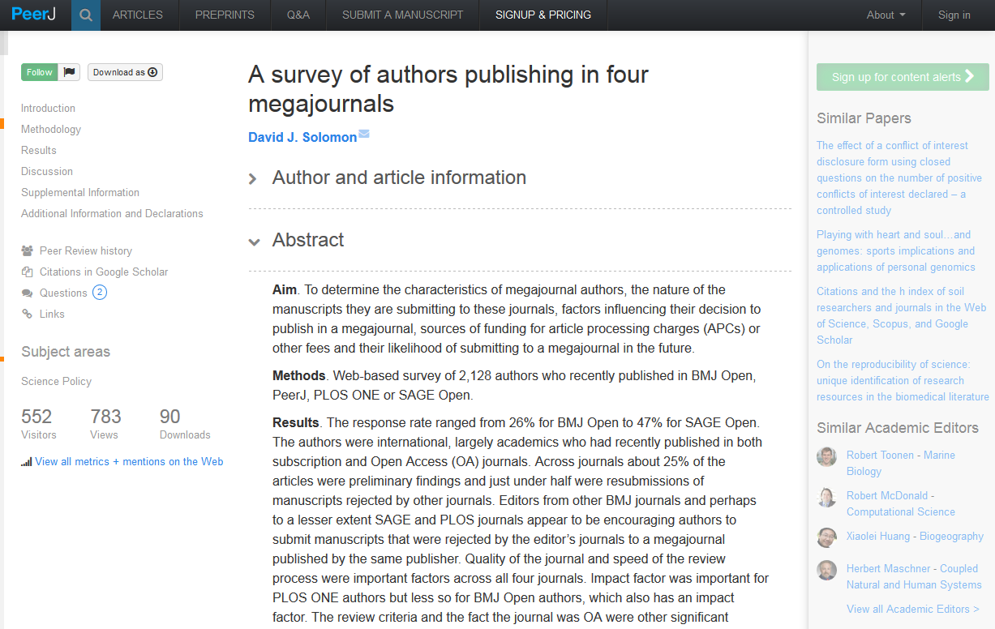

Slide 29
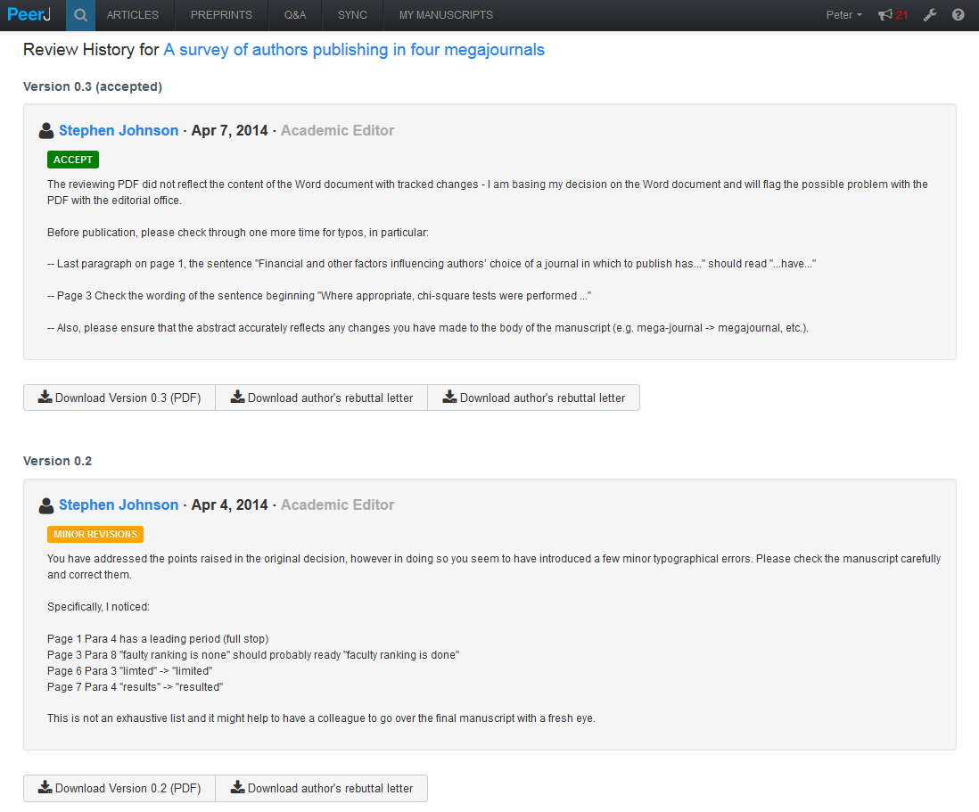

Slide 30
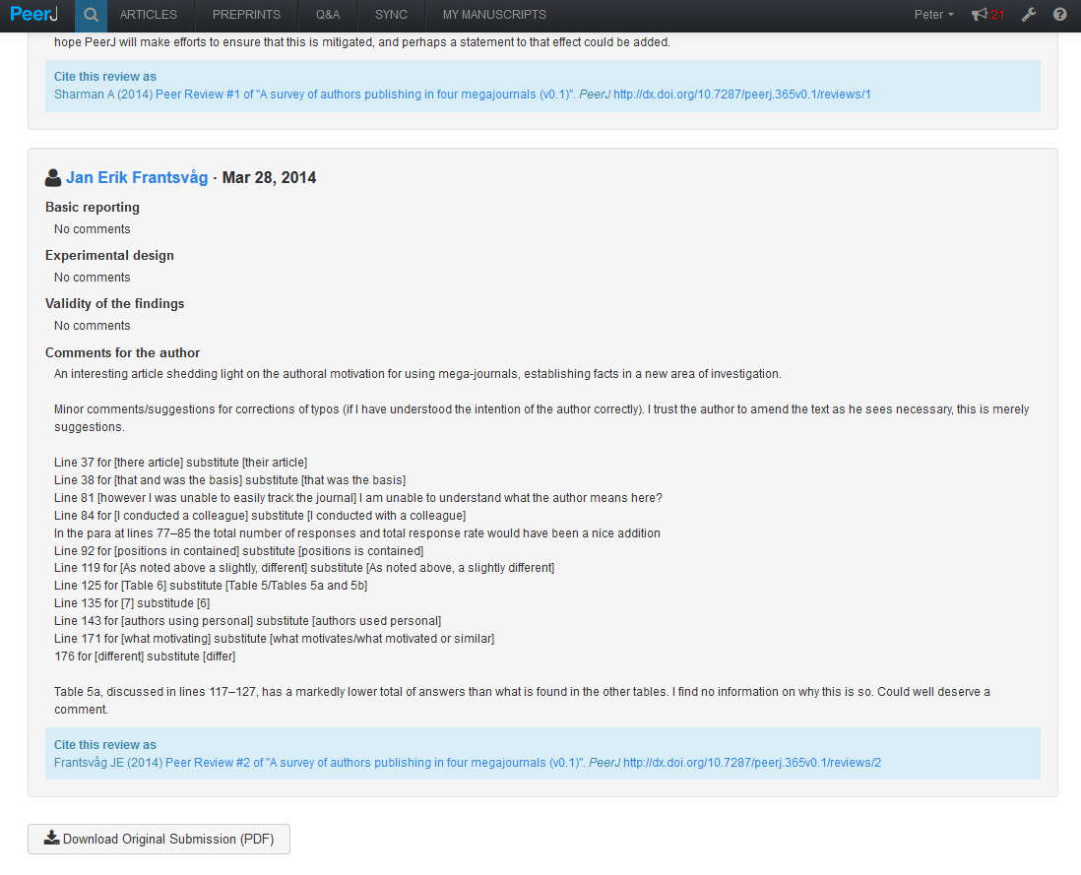

Slide 31
Feedback / Q&A
Feedback / Q&A

Slide 32
Progress to Date
>360 PeerJ Articles (since Feb 2013)
~400 PeerJ PrePrint Articles (since April 2013)
~40% of reviewers provide their names
>85% of authors choose to reproduce their peer review history publicly
1st decisions are rendered in 24 days
~840 Academic Editors, 5 Nobel Laureates
~30 Institutional Libraries are Funding PeerJ Plans
Stanford, Berkeley, UCL, Amsterdam, Duke etc

Slide 33
The Institutional Deposit Account at PeerJ http://PeerJ.com.edu

Slide 34
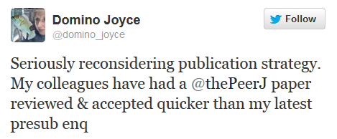
}
91%

Slide 35
Thank You
Pete Binfield
Co-Founder and Publisher
@p_binfield
pete@peerj.com
@ThePeerJ
Sign Up for a Free Membership at www.PeerJ.com

Slide 36
End

